Slide 1
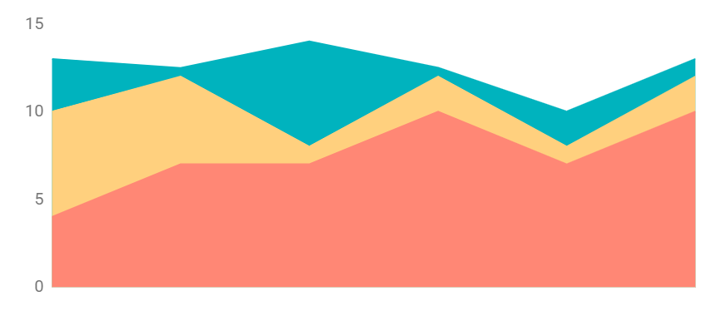
Flat Dashboard Infographics
$265
$159
$158
Mars is actually a cold place
Earth is where we all live on
Pluto is an icy dwarf planet
300
200
100
50%
75%
0
Mercury
Saturn
Mercury is the smallest planet
It’s a gas giant and has rings
Jan
Feb
Mar
Apr
May
Jun
To modify this graph, click on it, follow the link, change the data and paste the new graph here

Slide 2
Flat Dashboard Infographics
Jupiter
Mercury
Mercury
563
Venus
Mon
Tue
Wed
Thu
Fri
Sat
Sun
Venus
Mars
Earth
980
Neptune
Earth
Earth
Jupiter
Venus
50%
Mars
Mars
Mars
10%
Venus
Venus
1 156

Slide 3
Flat Dashboard Infographics
Mars
Earth
Mars is actually a cold place
Earth is where we all live on
25K
Pluto is an icy dwarf planet
35%
15
18
13
29
15
17
Jupiter
Venus
Mercury
Venus has a beautiful name
35%
45%
65%
Saturn
It’s a gas giant and has rings
60%
Mercury is the smallest planet
10
20
30
40
50
60

Slide 4
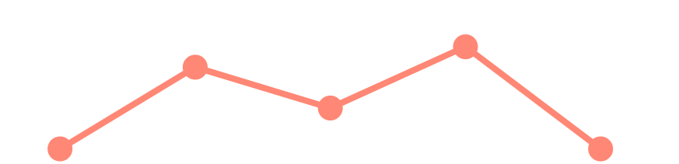
Flat Dashboard Infographics
Mercury
Venus
Neptune
Mercury is the smallest planet
Mars
Mars is actually a cold place
May
Jun
Jul
Aug
Sep
Earth
Venus
To modify this graph, click on it, follow the link, change the data and paste the new graph here
Mars
Pluto
Mars
1 566
Venus
4 562
Earth
2 698
Pluto
3 185
Mars
Mars is actually a cold place
Mercury
Venus
26.09.20
Venus has a beautiful name
It’s the smallest planet in the Solar System
Earth
Earth is where we all live on

Slide 5
Flat Dashboard Infographics
Earth
Venus
265 985 156
Mercury
+8%
300
200
70%
$568
100
Earth is where we all live on
0
Jan
Feb
Mar
Apr
May
Neptune
Jupiter
+25%
01
02
Mercury
Pluto
Mars
256 598
Mercury is the smallest planet
Pluto is an icy dwarf planet
$568,562
Venus
659 854

Slide 6
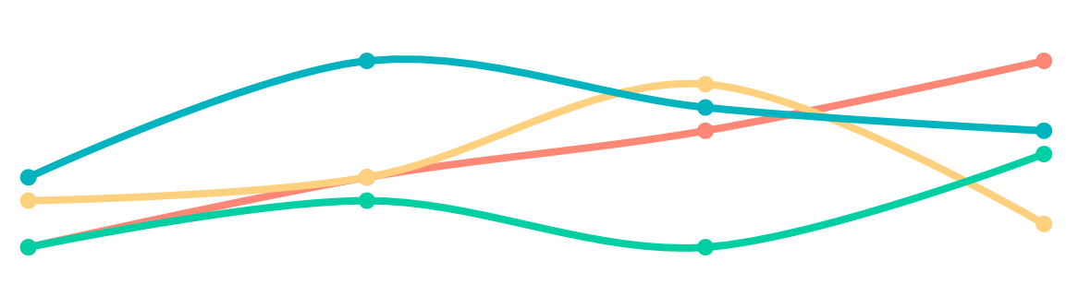
Flat Dashboard Infographics
Mars
20%
M
T
W
T
F
S
S
1
2
3
4
5
6
7
Venus
10%
8
9
10
11
12
13
14
Earth
Jupiter
50%
15
16
17
18
19
20
21
22
23
24
25
26
27
28
Saturn
20%
29
30
31
Jupiter is the biggest planet
Venus has a beautiful name
Mars is actually a cold place
Earth is where we all live on
To modify this graph, click on it, follow the link, change the data and paste the new graph here

Slide 7
Flat Dashboard Infographics
Neptune is very far away
Neptune
+20%
Earth is where we all live on
Earth
+5%
Mercury is the smallest planet
Mercury
+90%
Saturn
Mars
It’s a gas giant and has rings
Mars is actually a cold place
Jupiter
Venus
Jupiter is the biggest planet
Venus has a beautiful name
Neptune
4/7
Mercury
5/7
Earth
6/7
Pluto
3/7

Slide 8
Flat Dashboard Infographics
Jupiter
+25%
Mars
+10%
Neptune
+5%
23%
48%
Jupiter
Venus
Jupiter is the biggest planet
Venus has a beautiful name
Venus
Venus has a beautiful name
19%
10%
Saturn
Mars
It’s a gas giant and has rings
Mars is actually a cold place
Venus
Mars
Earth

Slide 9
Flat Dashboard Infographics
60%
Saturn
Jupiter
Neptune
75%
Mars
Jupiter is the biggest planet
Neptune is very far away
70%
Neptune
30%
40%
45%
50%
45%
10%
45%
45%
Earth
Venus
40%
25%
15%
Earth is where we all live on
Venus has a beautiful name
10%
Venus
Mars
Earth

Slide 10
Flat Dashboard Infographics
Saturn
Jupiter
It’s a gas giant and has rings
Jupiter is the biggest planet
Venus
Venus has a beautiful name
Neptune
Neptune is very far away
It’s a gas giant and has rings
Neptune
Saturn
Mercury
Mercury is the smallest planet
M
T
W
T
F

Slide 11
Flat Dashboard Infographics
156,156
158,962
159,365
597,412
It’s a gas giant and has rings
Mars is actually a cold place
Jupiter is the biggest planet
Venus has a beautiful name
70%
40%
85%
45%
70%
50%
Venus
Mars
Earth
Mercury
1
2
3
4
5
6
7

Slide 12
Flat Dashboard Infographics
300
40%
200
30%
50%
100
0
20%
60%
Jan
Feb
Mar
Apr
May
Jun
Venus
Mars
Earth
10%
70%
80%
Mercury
Mercury is the smallest planet
Neptune
Neptune is very far away
Mars
Mars is actually a cold place

Slide 13
Flat Dashboard Infographics
300
30%
Jupiter
25%
Jupiter is the biggest planet
200
15%
18%
100
Saturn
0
It’s a gas giant and has rings
Jan
Feb
Mar
Apr
May
Jupiter
Saturn
Mars
Venus
Jupiter is the biggest planet
It’s a gas giant and has rings
Mars is actually a cold place
Venus has a beautiful name

Slide 14
Flat Dashboard Infographics
Jupiter
+25%
$568,562
$568
Earth is where we all live on
Mercury
+10%
$246
$125,687
It’s a gas giant and has rings
Venus
Mars
Earth

Slide 15
Flat Dashboard Infographics
A
50%
B
75%
C
25%
D
60%
30%
Mars
80%
Venus
20%
Jupiter
Jupiter
Saturn
Jupiter is the biggest planet
It’s a gas giant and has rings
90%
Saturn

Slide 16
Flat Dashboard Infographics
Saturn
Jupiter
27%
2018
2019
2020
Venus
Jupiter
Jupiter
Saturn
Jupiter is the biggest planet
It’s a gas giant and has rings
Saturn

Slide 17
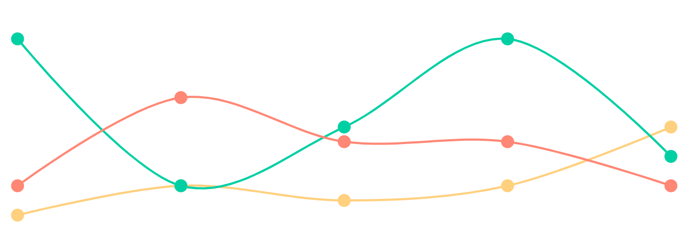
Flat Dashboard Infographics
300
Mars
200
Venus
Jupiter
100
To modify this graph, click on it, follow the link, change the data and paste the new graph here
0
Jan
Feb
Mar
Apr
May
125,946
157,954
365,789
Jupiter is the biggest planet
Venus has a beautiful name
Mars is actually a cold place

Slide 18
Flat Dashboard Infographics
Jupiter
Venus
Neptune
Mars
+156
+985
Jupiter
85%
Saturn
40%
Jupiter is the biggest planet
Venus has a beautiful name
+569
Venus
50%
Saturn
Earth
85%
75%
50%
25%
75%
Venus
Mars

Slide 19
Flat Dashboard Infographics
Jupiter
01
02
03
Mercury
Mercury is the smallest planet
40%
Pluto
50%
Pluto is an icy dwarf planet
Mon
Tue
Wed
Thu
Fri
Sat
Sun
70%
Venus
Mars
Earth
Mercury

Slide 20
Flat Dashboard Infographics
Jupiter
+25%
27%
32%
72%
$568,562
300
Jupiter
Venus
02
Jupiter is the biggest planet
Venus has a beautiful name
200
03
04
100
01
Saturn
Mars
0
It’s a gas giant and has rings
Mars is actually a cold place
10
20
30
40
50
60

